Slide 1
ForLens – A Lightweight AI-Driven Endpoint Security Solution for Real-Time Threat Detection in SMEs
25-26J-076

Slide 2
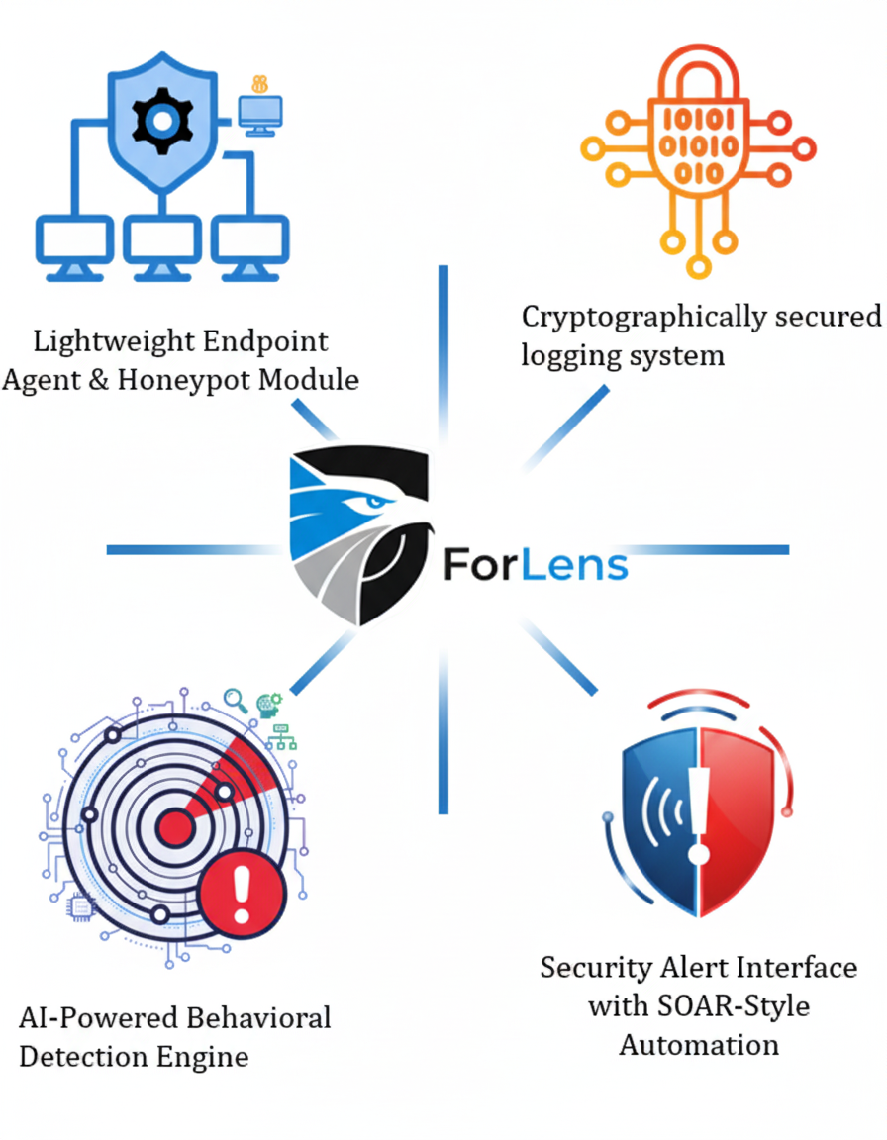





Overall Project Description
Research Problem
Small and medium-sized enterprises (SMEs) face a growing risk from threats, both malicious and accidental. These threats cause major Operational and Financial damages to SMEs.
Enterprise-grade security tools (e.g., SIEMs, EDRs, SOAR platforms) are either too resource-intensive, costly, or complex for SMEs to adopt.
Most enterprise grade solutions utilize AI & ML algorithms which are black box in nature.
Forensic logging systems are often centralized and prone to tampering, making it difficult to ensure trustworthy evidence during incident response.
Cryptographically secured logging system
Lightweight Endpoint Agent & Honeypot Module
Security Alert Interface with SOAR-Style Automation
AI-Powered Behavioral Detection Engine

Slide 3

Design Excellence
Modular & Integrated: Combines endpoint agent, AI detection, secure logging, and SOAR dashboard.
Lightweight & Efficient: Minimal resource usage; optimized for SMEs.
Secure & Resilient: Tamper-proof logs, self-protecting agent, offline capability.
Automated & User-Friendly: SOAR workflows + AI assistant for non-technical users.
Scalable & Maintainable: Modular updates, plug-and-play deployment.

Slide 4



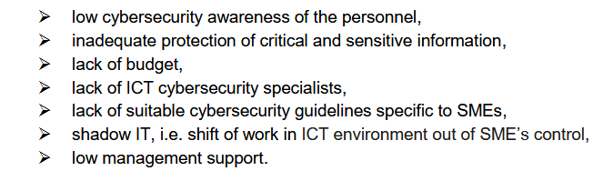
M. F. Arroyabe, C. F. A. Arranz, I. F. de Arroyabe, and J. C. F. de Arroyabe, "Revealing the realities of cybercrime in small and medium enterprises: Understanding fear and taxonomic
perspectives,"

Slide 5

Student Must add
a professional
photo to this cage
IT22908742 | MRF Nusfa
Lightweight Endpoint Agent Integrated with Honeypot Module
Specialization: Cyber Security
IT22908742 | MRF Nusfa | 25-26J-076

Slide 6
Lightweight Endpoint Agent Integrated with Honeypot Module
How the Solution Addresses the Sub-Problem / Prototype
Addresses the lack of continuous endpoint visibility in SME environments by deploying a single lightweight agent optimized for low-resource endpoint devices
Solves early attacker detection gaps by integrating a low-interaction honeypot within the endpoint agent itself
Overcomes agent tampering and deletion risks through a delete-proof design with built-in self-protection mechanisms
Reduces attacker awareness of monitoring by operating in stealth mode without user-visible indicators
Enables rapid SME adoption through a plug-and-play deployment model requiring minimal configuration
Supports endpoint-level response execution by allowing the agent to carry out response commands (e.g., process termination, blocking) received from the external engine
User Requirements Addressed
Easy deployment on SME endpoints
Low performance overhead
Resistance to attacker tampering
Continuous endpoint visibility
Early attack awareness at endpoint level
Reliable forwarding of endpoint telemetry
IT22908742 | MRF Nusfa | 25-26J-076
5/1/2026
13

Slide 7
Lightweight Endpoint Agent Integrated with Honeypot Module
Design Excellence / Contribution
Unified lightweight endpoint agent Runs a single combined agent for end point monitoring and deception on SME endpoints
Integrated endpoint honeypot (deception-based detection) Uses deception-based attacker interaction instead of heavy signature-based detection
Delete-proof self-protection mechanism Prevents agent termination or removal by attackers
Secure telemetry forwarding design Reliably forwards endpoint telemetry to the external analysis engine without local log storage
Stealth-mode agent operation Operates silently without user-visible indicators
Modular, multi-threaded plug-and-play design Uses modular components and threading to run monitoring tasks concurrently with minimal configuration
Endpoint-level response execution support Allows the agent to execute response commands (e.g., process termination, blocking) received from the external engine
User Feedback on Prototype
Initial testing shows the single integrated agent can run alongside normal endpoint activity without disruption
Honeypot interactions successfully generated early attack indicators during simulated access attempts
The lightweight design demonstrated low system impact during continuous monitoring
IT22908742 | MRF Nusfa | 25-26J-076
9/8/2025
14

Slide 8

IT21289934 | MBD Salgado
AI – Powered Behavioral Detection Engine
Specialization: Cyber Security
IT21289934 | Salgado M B D | 25-26J-076
9/8/2025
12

Slide 9
AI – Powered Behavioral Detection Engine
How the Solution Addresses the Sub-Problem / Prototype
Addresses the problem of high false positives and low contextual awareness in traditional anomaly detection systems
Combines Threat Intelligence (TI), MITRE ATT&CK mapping, and unsupervised ML models (Isolation Forest, LSTM Autoencoder)
Converts raw security logs into context-aware, high-fidelity alerts through correlation
Bridges the gap between statistical anomalies and real attack techniques
User Requirements Addressed
Detect threats and advanced persistent behaviors without labeled data
Provide explainable alerts mapped to known attack techniques (MITRE)
Reduce analyst workload
Support plug-and-play ingestion of logs from multiple agents/sources
IT21289934 | Salgado M B D | 25-26J-076
9/8/2025
13

Slide 10
AI – Powered Behavioral Detection Engine
Design Excellence / Contribution
Hybrid Detection Architecture
Isolation Forest → Point anomalies
LSTM Autoencoder → Sequential behavior anomalies
Hybrid Scoring → Robust anomaly confidence
Threat Intelligence Aggregation Layer
ThreatFox + URLHaus + MITRE ATT&CK integration
Correlation Engine
Fuses ML anomalies + TI hits + behavioral context
Explainability-Ready Design
MITRE techniques, severity, confidence, rationale attached to alerts
User Feedback on Prototype
Security analysts found alerts more actionable due to MITRE tagging
Reduced noise: only ~1% high-risk user-days flagged after correlation
Hybrid model showed strong overlap (≈77–78%) with LSTM anomalies, improving trust
IT21289934 | Salgado M B D | 25-26J-076
9/8/2025
14

Slide 11

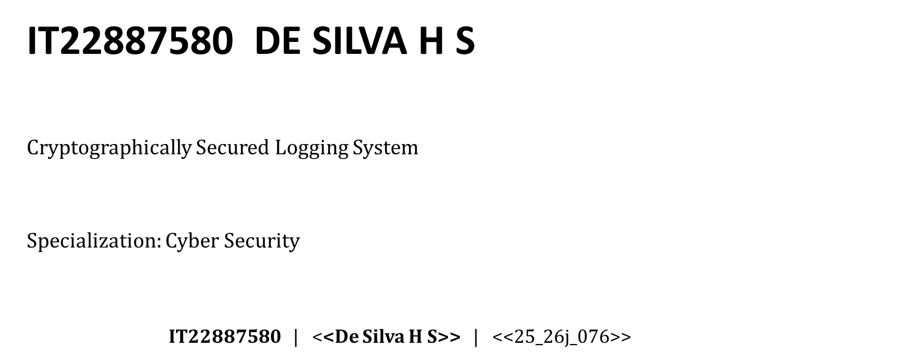
9/8/2025
18

Slide 12
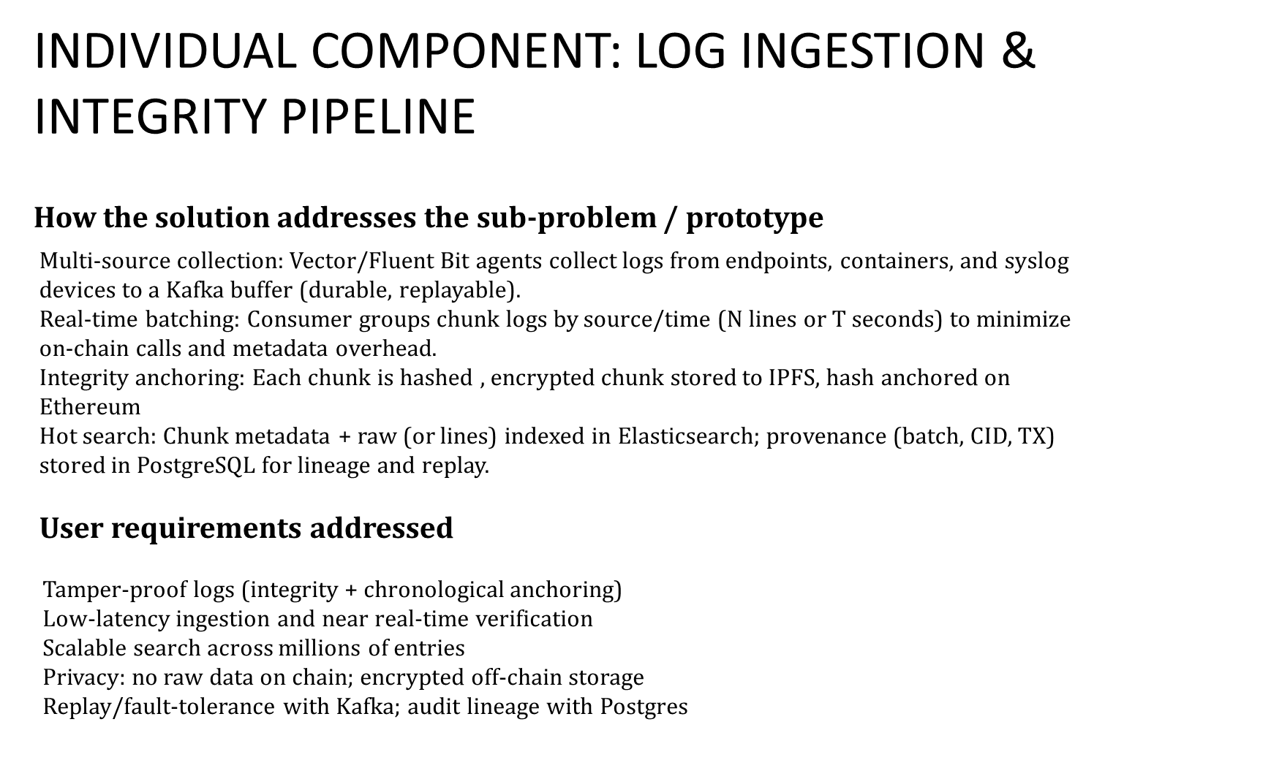
9/8/2025
19

Slide 13

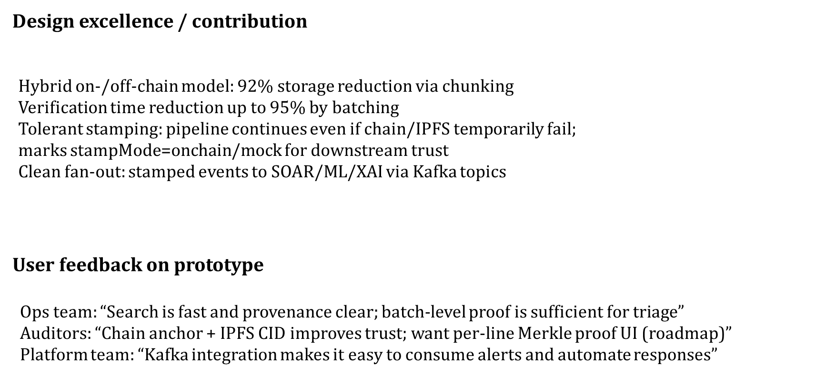
9/8/2025
20

Slide 14


Student Must add
a professional
photo to this cage
Security Alert Interface with SOAR-Style Automation
Specialization: Cyber Security
IT22340078 | SANJULA E A Y | 25-26J-076
9/8/2025
23

Slide 15
Security Alert Interface with SOAR-Style Automation
How the Solution Addresses the Sub-Problem / Prototype
SMEs lack skilled SOC teams and advanced automation tools.
This module provides a centralized dashboard that:
Collects and normalizes alerts from multiple sources.
Prioritizes threats using role-aware risk scoring.
Automates response workflows (isolate endpoints, block IPs, terminate processes).
Enables autonomous containment and remediation without SOC dependency.
User Requirements Addressed
Ease of Use: Intuitive dashboard for non-technical users.
Automation: SOAR-style playbooks for quick response.
Explainable Alerts: Clear, human-readable threat insights.

Slide 16
Security Alert Interface with SOAR-Style Automation
Design Excellence / Contribution
Lightweight SOAR for SMEs: Enterprise-grade automation in a cost-effective design.
Behavior-Driven Workflow Adaptation: Adjusts based on user responses.
Feedback-Driven Threat Intelligence: Improves accuracy and reduces false positives.
Security-Aware Integration Layer: Seamless orchestration across endpoints.
User Feedback on Prototype
Ease of Use: Intuitive dashboard for non-technical users.
Explainable Alerts: Clear, human-readable threat insights. However, takes a bit too long to provide responses.
Alerts are getting updated in real time.

Slide 17


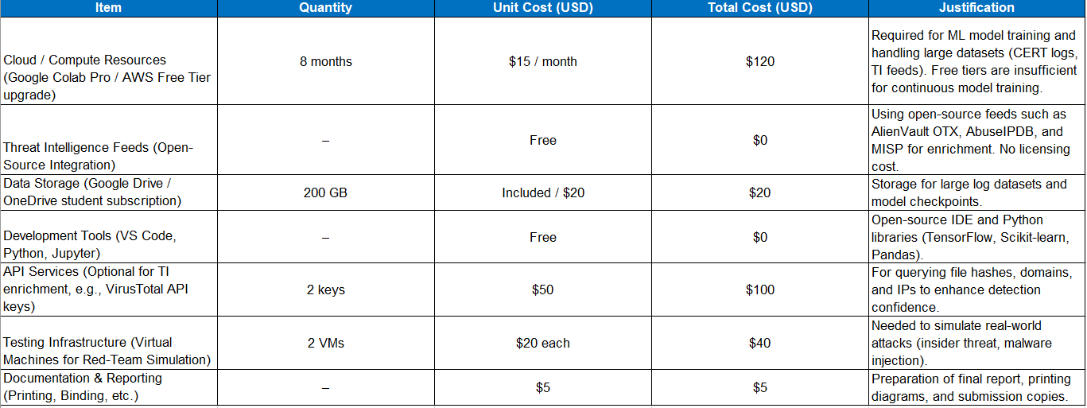
Commercialization
Market Gap: SMEs face Cyber threats but can’t afford enterprise tools (e.g., Splunk, Varonis) and lack technical expertise.
Value Proposition: Lightweight, AI-driven detection + honeypot traps + tamper-proof logging + SOAR-like automation, all SME-friendly.
Target Market: SMEs; Managed Service Providers (MSPs).
Business Model: SaaS subscription (per endpoint/month)
Advantages: Affordable, scalable, compliance support, unique vs. open-source tools.
Challenges: Competing with free tools, reducing false positives, scaling support.
Roadmap: Prototype → MVP pilot with SMEs → SaaS subscription → MSP partnerships → Expansion.
Source: World Bank
Real World Usage
Simple and Proactive Security: Unified dashboard, self learning.
Fast and Automated Response: Immediate actions, automated workflows, One click control
Advanced benefits: Custom playbooks, Automated & business reporting
Total Investment for prototype with buffer: $485
9/8/2025
28

Slide 18
References
M. F. Arroyabe, C. F. A. Arranz, I. F. de Arroyabe, and J. C. F. de Arroyabe, "Revealing the realities of cybercrime in small and medium enterprises: Understanding fear and taxonomic perspectives,“
European Union Agency For Cybersecurity, June 2021, “Cybersecurity for SMEs – Challenges and Recommendations. [Online]. Available: https://www.enisa.europa.eu/publications/enisa-report-cybersecurity-for-smes
C. Gates, et al., “Detecting Insider Threats in Logs,” CERT, CMU, 2011.
IBM, “IBM QRadar SIEM Overview,” 2023.
AlienVault, “Open Threat Exchange (OTX),” [Online]. Available: https://otx.alienvault.com
AbuseIPDB, “IP Blacklist & Threat Feed,” [Online]. Available: https://www.abuseipdb.com

